Slide 1
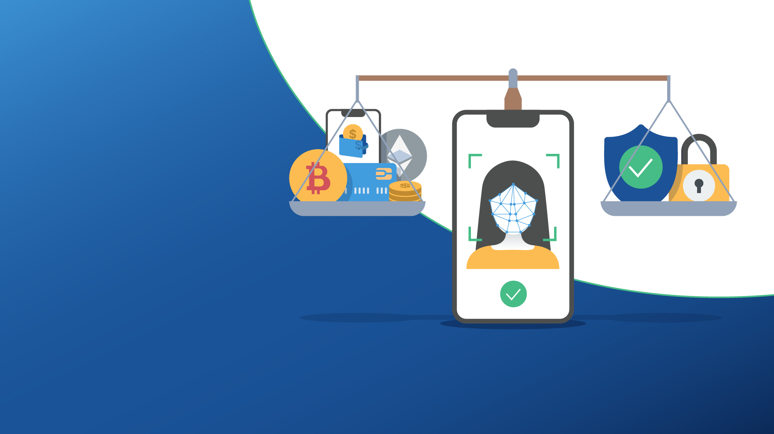
Striking the Balance: Security and Usability with Face Biometrics
Aarti Samani SVP Product & Marketing, iProov
22 March 2022
© iProov 2022

Slide 2
To establish trust in remote users with face verification
iProov assures the Genuine Presence® of people asserting their identity online
Delivering effortless,
device-independent authentication, tied to trusted ID credentials
© iProov 2022
2

Slide 3
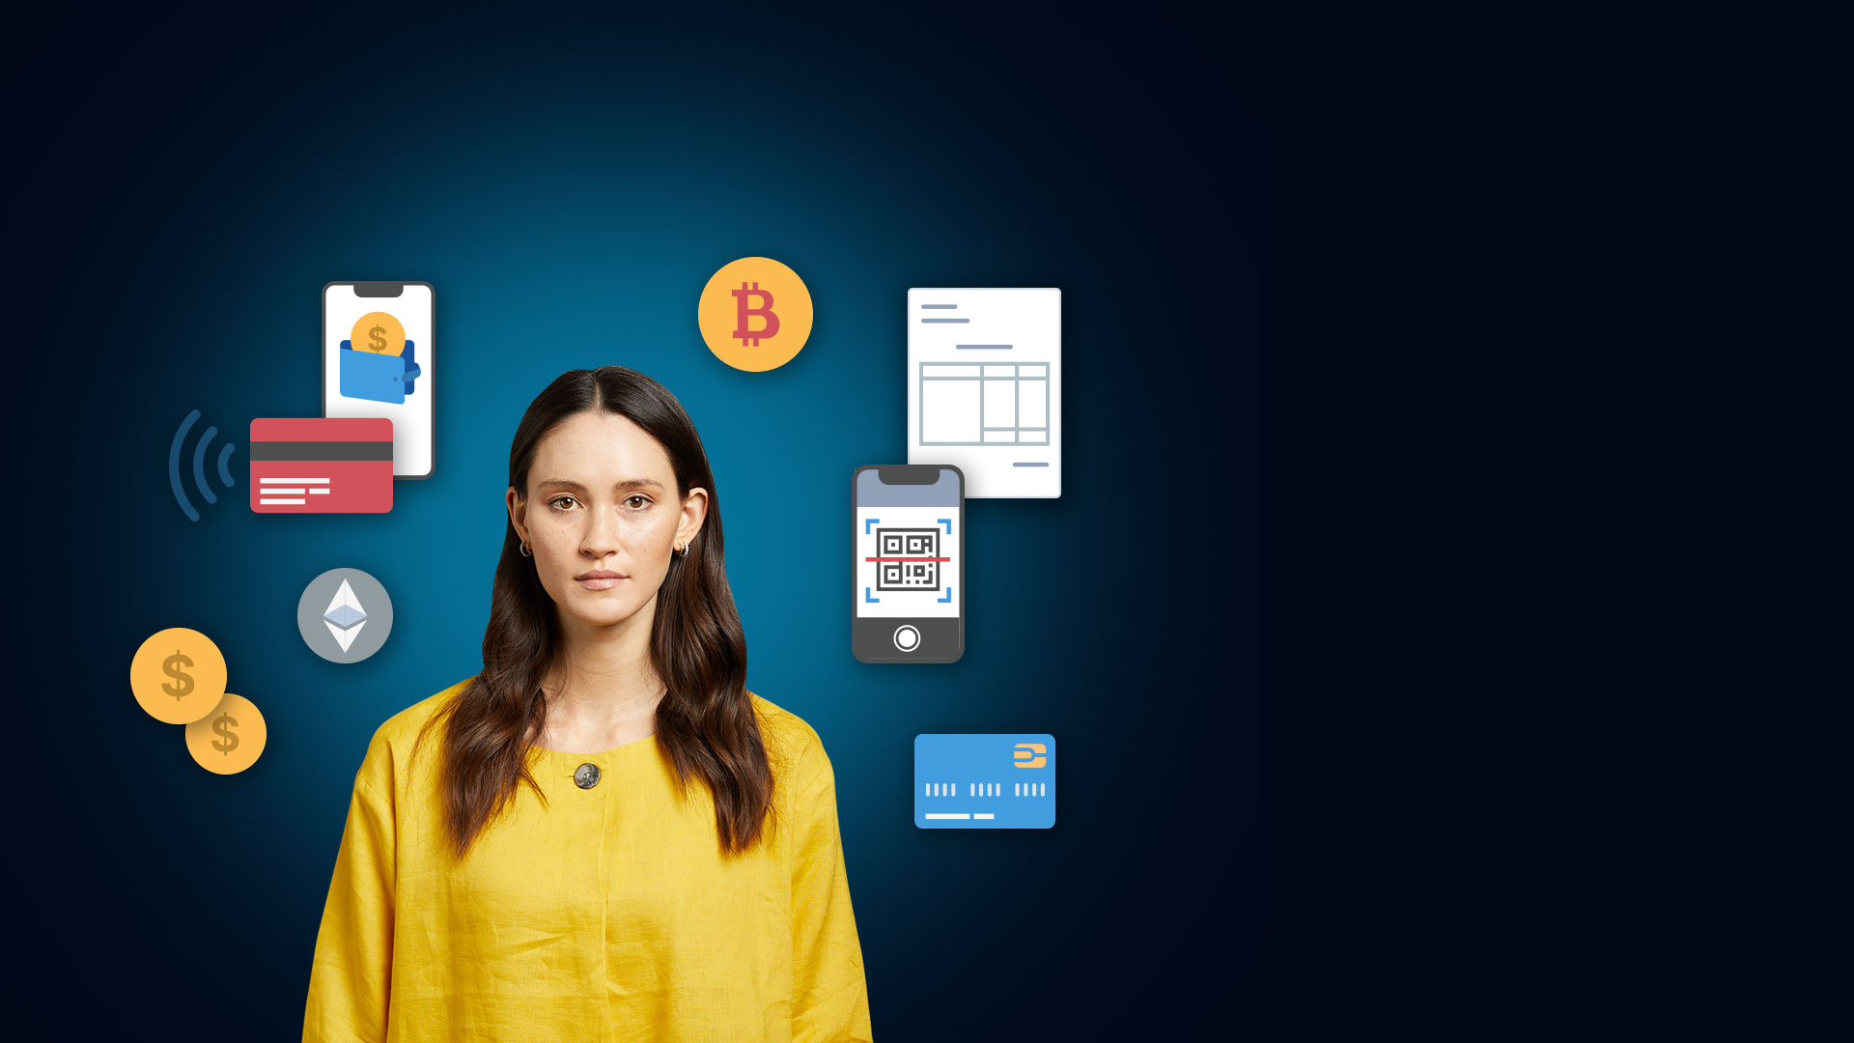
Proliferation of Payment Methods
M-Pesa now
processes more than
61 million
transactions a day
Juniper predicts
36 million
people will be using Digital Wallets in 2022
© iProov 2022
3

Slide 4
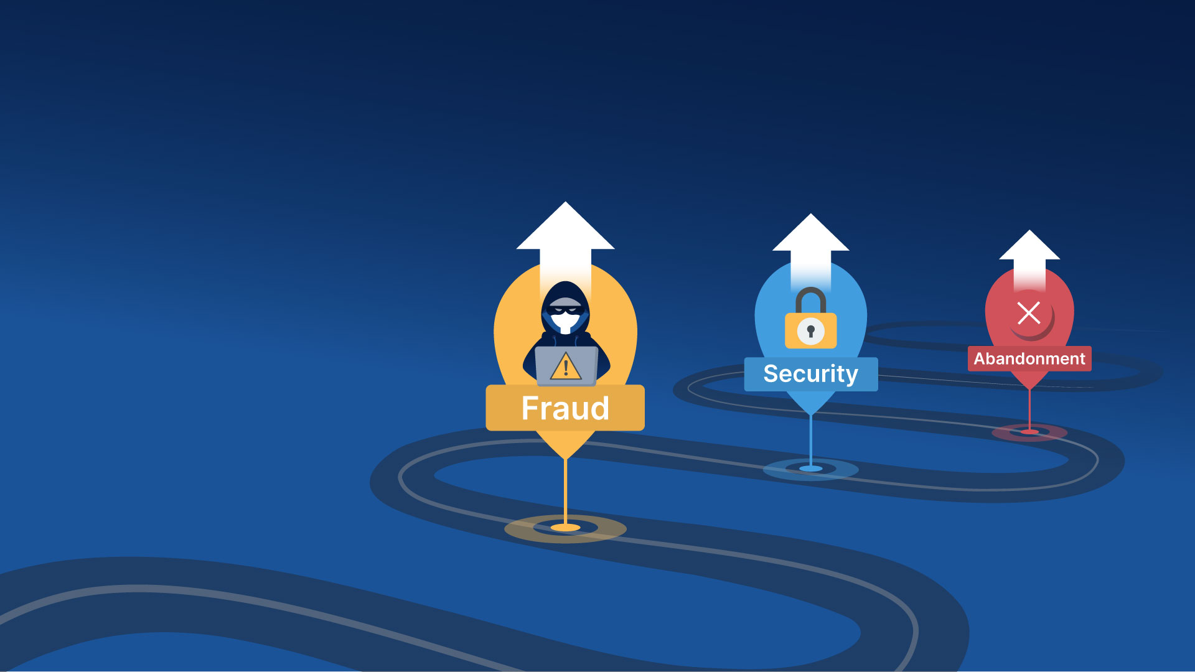
Lost Revenue Due to Abandonment
Global losses from payment fraud has tripled from $9.84 Billion in 2011 to
$32.39 Billion
in 2020
37%
of shoppers went to another retailer to complete their purchase
© iProov 2022
4

Slide 5
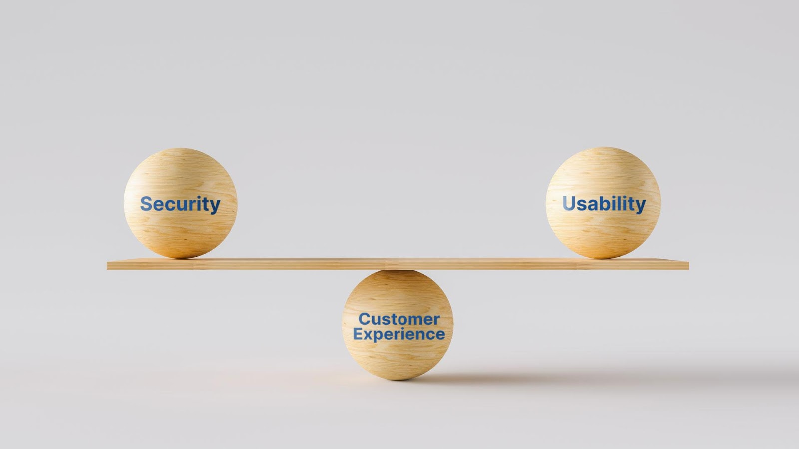
Strike the Balance
A survey by Mastercard found
81%
of respondents would be interested in new services banks and payment companies offer as long as they are proven to be secure
78%
were interested in new services if it made their life easier
© iProov 2022
© iProov 2022
5

Slide 6
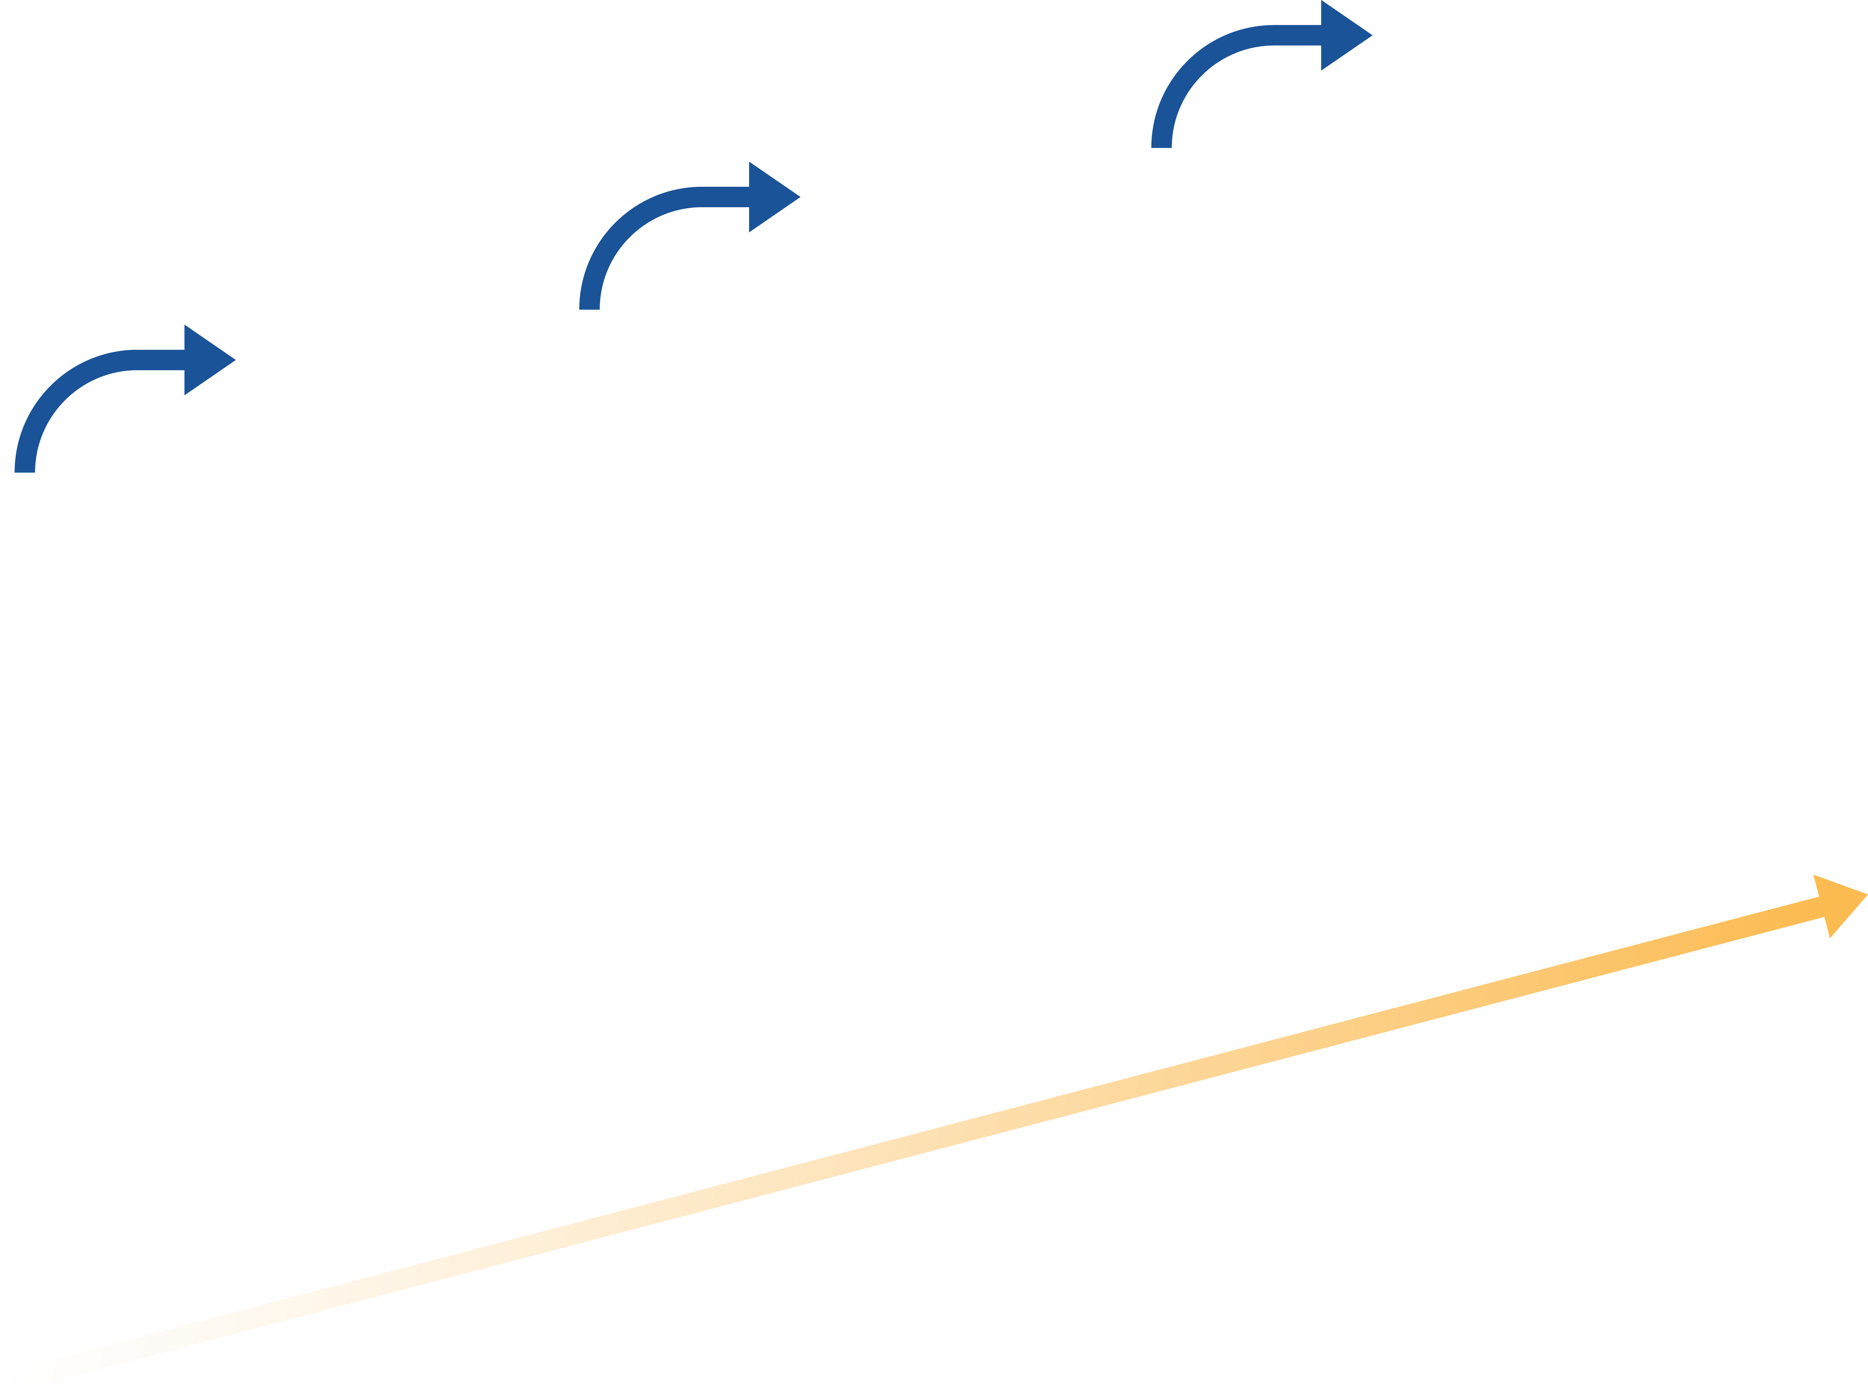
The Evolution: Stronger Security While Removing Unwanted Friction
75%
of online buyers fail to complete transactions because they’ve forgotten their password
Passive face biometric
Fingerprint
Fingerprint
Effortless + Unique + Inclusive
OTP SMS / email
Unique
Device restricted
86%
OTP SMS / email
Password
Single use code
Journey breakage
of consumers would
like to use biometrics to approve payments
Easy to use
Easy to breach
SECURITY

Slide 7
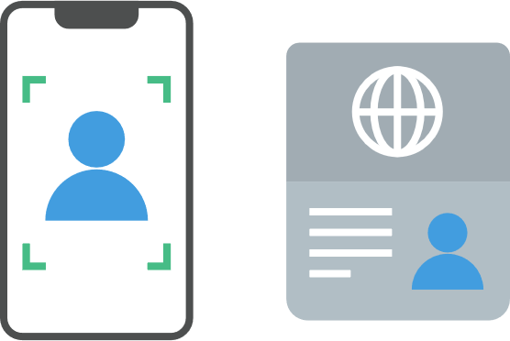
Cloud-based Face Biometrics for Strong Authentication
Faces can be verified against a Government issued photo ID
No specific hardware or sensors needed
Contactless by default - can be used with any device with a camera
Biometric richness supports high performance and security
© iProov 2022
7

Slide 8
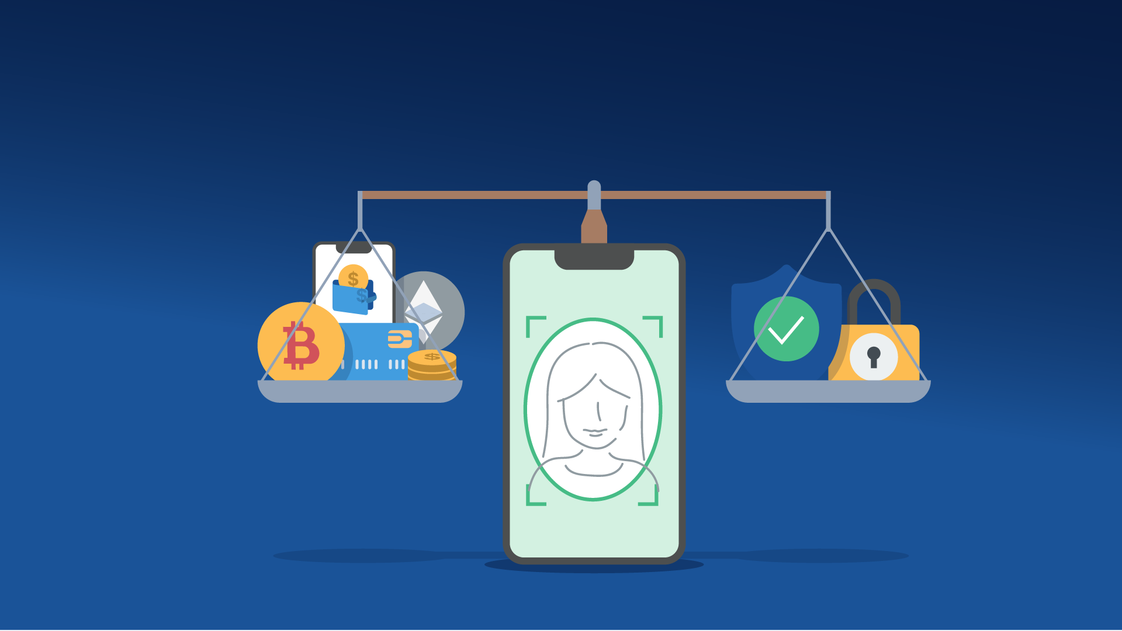
With a User-centric Approach it is Possible to Achieve the Balance
© iProov 2022
8

Slide 9
Aarti Samani, SVP Product & Marketing
aarti.samani@iproov.com
Come and talk to us at booth 21

