Slide 1



Embedded, payment
solutions:
It’s in our DNA

Slide 2









Who we are
11
24
£5bn+
Principal member of Visa and Mastercard
Licensed by the Malta Financial Services Authority (MFSA)
Application in process with UK FCA
PCI DSS Level 1 certified
Certified vendor in key US states
Global
Offices
Years’
experience
Annualised
Volume
20,000+
15
Customers
Languages
supported

Slide 3





Commerce is Blending
The world’s largest taxi company owns no vehicle's
The largest accommodation provider own no real estate
The most popular media provider creates no content
The most valuable photo company sells no cameras
The fastest growing television network lays no cables
Notes:
With the growth of marketplaces and platforms the merchant-consumer or buyer-seller relationships have changed
Tech giants are now payment processors without necessarily owning the assets they are famous for

Slide 4




















The Trust Payments Commerce Offering
Trust Payments have expanded to address the broader commerce needs of our customers
What we
offer today
POS
E-Commerce
Converged
Commerce
Loyalty
TRU Coin & Crypto
Social Selling
QR Code
Banking as
a Service
Merchant Payment Accounts
Real Time Settlement
Instant Payouts
Cash Management
Payments as a Service
New Card Types
APMs
Subscriptions
SmartPOS - SoftPOS
BNPL
Fraud
Enabling Tech.
``
`
Data Lake
API-first
Blockchain
AI/ML
Cloud Native
Notes:
The Trust Payments product vision has changing customer behaviour at its heart and we aim to differentiate and disrupt with insights, focus on user experiences and innovative products
We are delivering Products as a service offerings across payments, banking and commerged commerce

Slide 5


01
The world has changed
5

Slide 6

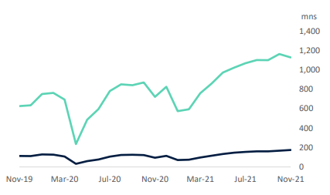
Payments in the time of Covid
The growth in contactless payments
Notes:
Never let a good crisis go to waste – Winston Churchill
Rapid change in the last two years
Major growth in the use of contactless payments, while overall card txns grew 19% there was a 54% increase in the use of contactless credit card txns and 79.9% increase in contactless debit txns
In November in the UK contactless was 53% of credit and 69% of debit txns
In Ireland contactless transactions increased from 25% in 2017 to 52% last year

Slide 7


Payments in the time of Covid
The growth in contactless payments
QR codes: 25-year old technology
re-imagined
Click and Collect: Kerbside pickup – BOPIS!
The growth of delivery service
Converged Commerce TM
It’s in our DNA
Notes:
QR codes as a payment mechanism were very familiar to Asian consumers widely used in Konbini or convenience store payments in Japan or in Alipay and WeChatPay apps
Their use in store or in hospitality settings to allow people to order and pay online or make charity donations is a clear sign that payment experiences need to be omnichannel
Taken alongside trends like Click and Collect and BOPIS or Buy Online Pickup in Store Trust calls this ConvergedCommerce

Slide 8


02
It’s a consumer thing…
8

Slide 9

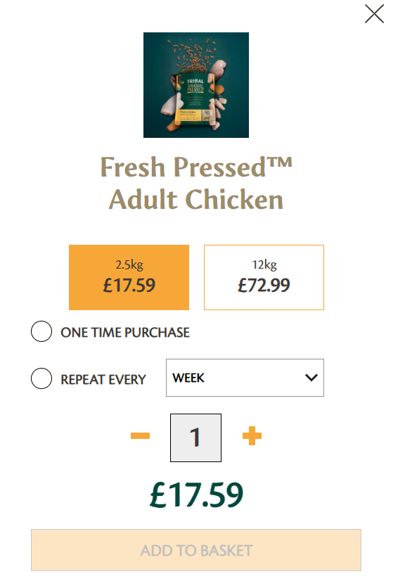

Subscription Economy
00
It’s not just about SaaS
Notes:
Converged Commerce means thinking like consumers do
Retailers need to keep up with customer expectations for example bringing their products into the subscription economy or simplyifying checkout processes

Slide 10
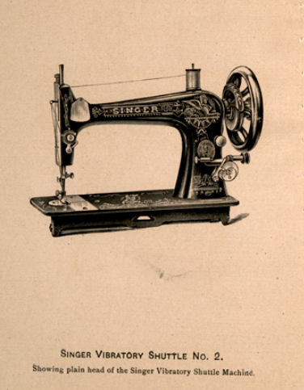
BNPL – 170-Year Old Payment Form Re-Imagined for the Digital Age
00
”Why not rent a sewing machine to the housewife and apply the rental fee to the purchase price of the machine? ”
&mdash1. Singer & Co.’s Gazette, 1856
Source: Harvard Business School Historical Collections
Notes:
While BNPL is one of the fastest growing trends it infact may be the easiest Fintech concept to explain if you are asked to explain it to your granny
Consumers need to spread payments over time particularly with the ongoing increases in the cost of living and BNPL is the digital re-imagination of the “dollar down, dollar a week” of the Singer Sewing Machine co

Slide 11
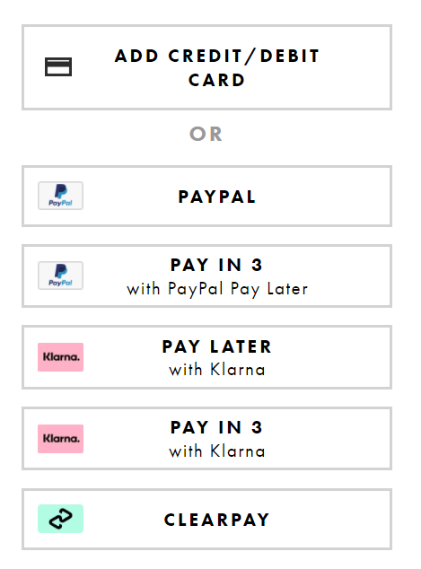
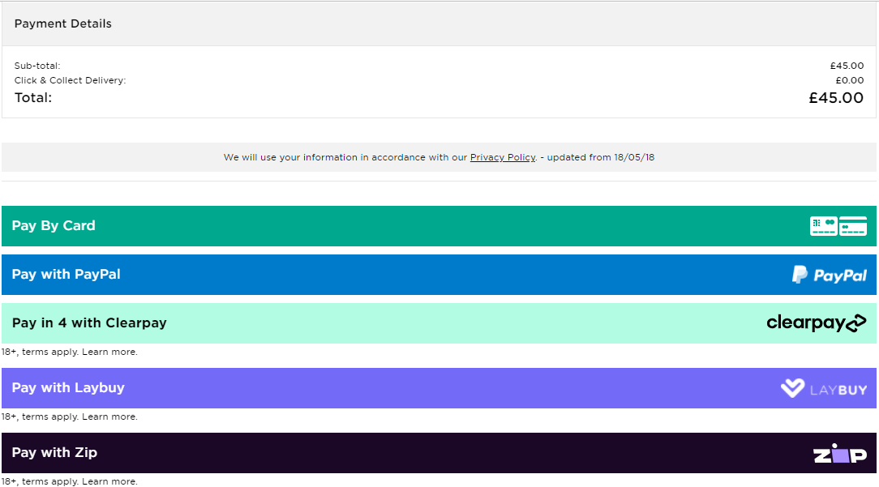
BNPL – 170 Year Old Payment Form Re-Imagined for the Digital Age
00
Crowded checkout?
Notes:
Choice and convenience may have to be balanced against the possibility of a crowded checkout and the risk of customer confusion

Slide 12

Customer
Experience
Retail as entertainment
Notes:
How do you get consumers off the couch and back into the high street store?
Lego – “Play well”
The enemy of any parent walking barefoot!
Their stores feature Retailtainment – a perfect example of phygital blending physical and digital experiences

Slide 13

Convergence of Customer Journeys
c
Search on mobile phone at lunchtime
Order on iPad at
dinner time
Register return on laptop or exchange
in store
According to Google research, 98% of US consumers switched devices during
the day
Notes:
Converged Commerce makes it easy for customer journeys to be seamless no matter where the customer is shopping
Whether you start on a device and purchase in store or vice versa or have to complete a return it’s important to offer a seamless experience

Slide 14
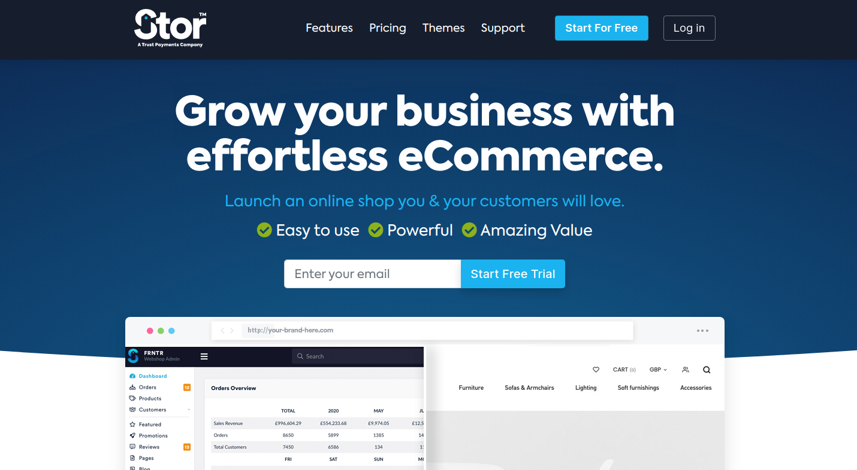
Fuelling online growth for SMEs
"A powerful all-in-one platform that offers a way to quickly launch your dream business and start selling to your customers, wherever they are."
Notes:
Trust have launched Stor which is helping smaller businesses to have the same impact online as larger businesses

Slide 15



New ways to pay
Account to Account – Open Banking Rails
Will this gain popularity in the UK to compare to success of iDeal in Netherlands
Crypto
Emergence of crypto linked debit cards using existing payment rails
Central Bank Digital Currencies (CBDC)
A New Era for Money
Notes:
As well as a seamless experience customers also want to be able to pay with their preferred method
Any retailer selling to Netherlands quite likely has implemented iDeal, if you haven’t Trust can help you accept the leading online payment method in the Netherlands with 57% of eCommerce payments compared to 11% credit card payments
Can Account to Account bank based payment methods gain similar popularity?
Much has been written about crypto however it’s use as a form of payment has largely been restricted but we are seeing crypto linked debit cards using existing payment rails
However the opportunity for a Digital Pound or Digital € offers the opportunity of major disruption and innovation and Trust were delighted to contribute to the recent Payments Association green paper A New Era for Money

Slide 16
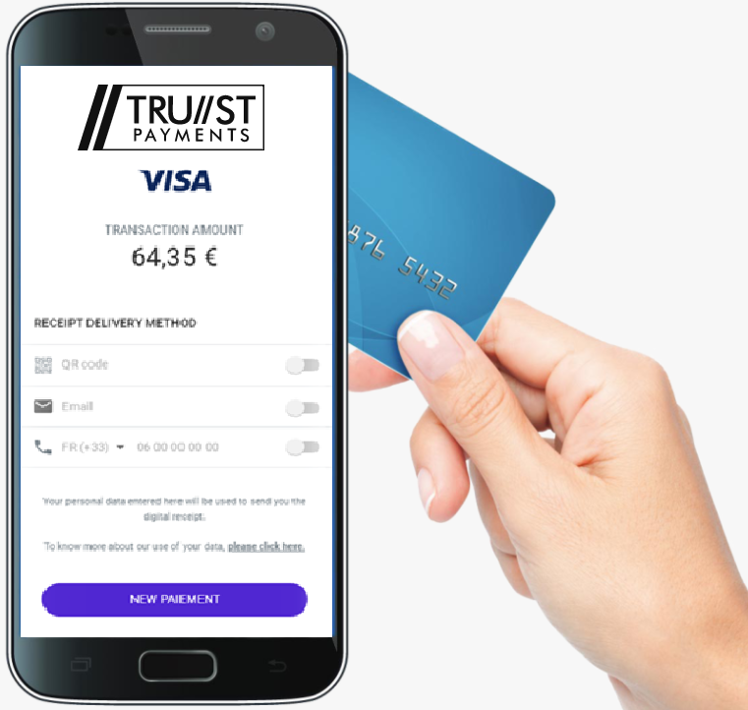
What are we paying on?
SoftPOS – everyone can be a merchant and every device a terminal
The Internet of Things
The frictionless checkout in the palm of your hand?
1
2
3
Notes:
With SoftPOS everyone can be a merchant and every device a terminal and of course Apple’s SoftPOS announcement is major news in the industry
With the Internet of Things we will see an increase in the use of beacons and wearables for payment
And as retailers look to bring frictionless checkout instore the likes of Amazon are linking biometrics to the payment

Slide 17



Security & Schemes Initiatives
SCA – the final hurdle passed
Secure Remote Commerce – Click to Pay
- The wallet to beat all wallets?
Scheme Network Tokenisation
- The schemes want your cards on file and they want them now
Thank you
Notes:
Of course when it comes to payments customers need to be re-assured their data and payments are secure and Trust is your trusted partner to ensure payments are secure
With the deadline for implementation of strong customer authentication last week we can expect further initiatives to be rolled out including Secure Remote Commerce or Click to Pay as well as the further rollout of network tokenisation from the schemes

Slide 18


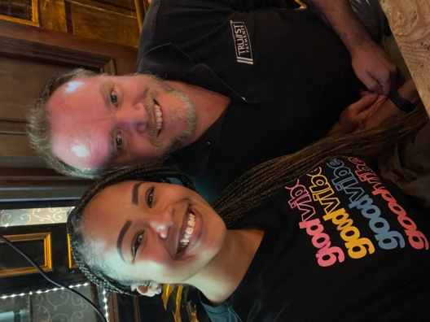
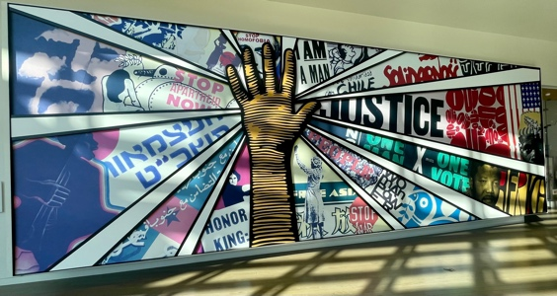
Our commitment to CSR, Diversity & Inclusion
Trust Payments is committed to running a sustainable business from both a profitability and human perspective. Our employees help us to ensure that we are contributing to these goals at all times. Some of the notable efforts in 2021 include:
Our dedicated Green Team organising several initiatives with environmental charities
Celebrating Pride month across the business
Circulating an education newsletter for LGBTQ+ History Month and Black History Month respectively
Securing ‘Disability Confident Committed’ employer status and being part of the government’s ‘Mindful Employer’ charter
Supporting the UK Government Kickstarter scheme to create new jobs for 16- to 24-year-olds on Universal Credit
Thank you

Slide 19
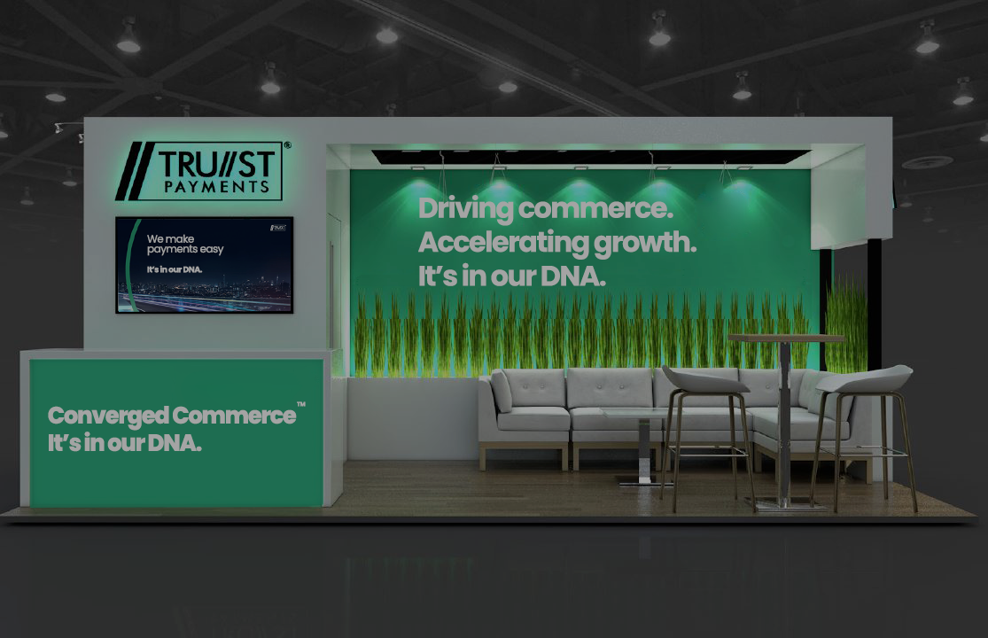



Please visit the Trust Team at Stand 6 in the Exhibition Hall
Thank you
ronan.gallagher@trustpayments.com
@payeire
linkedin.com/in/rajgallagher
It’s in our DNA…

Slide 20
Please visit the Trust Team at Stand 6 in the Exhibition Hall
Thank you
ronan.gallagher@trustpayments.com
@payeire
linkedin.com/in/rajgallagher
It’s in our DNA

